Slide 1
Talk: Web
by Hugo Lachkar

Slide 2
TABLE OF CONTENTS
01
04
Web ? Back ? Front ?
Example Front
02
05
Languages
Example Back
03
06
HTML / CSS / PHP
Where can you train ?

Slide 3
Web? Front ? Back ?

Slide 5
Languages

Slide 6
Languages
HTML/CSS
PHP/Python/Ruby/JS/...
JS (Node / React / Vue)

Slide 7
HTML / CSS / PHP
HEADER
TEXT
SLIDER
ICONS

Slide 8
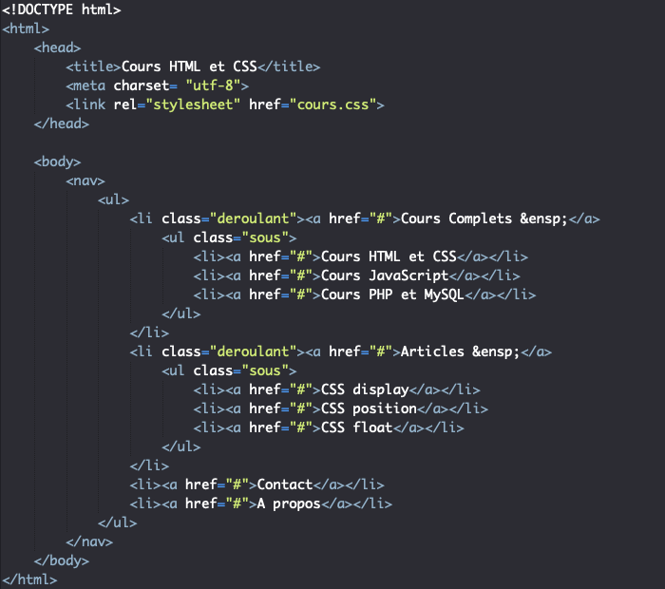
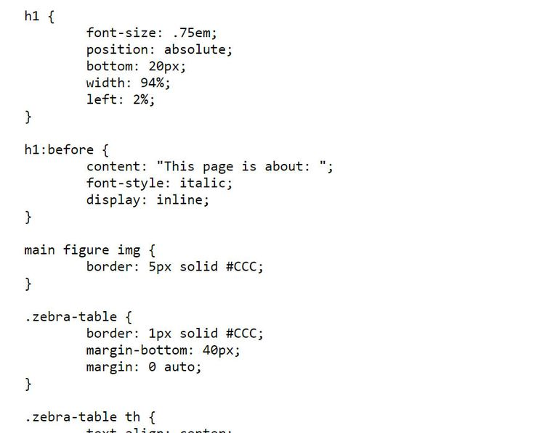
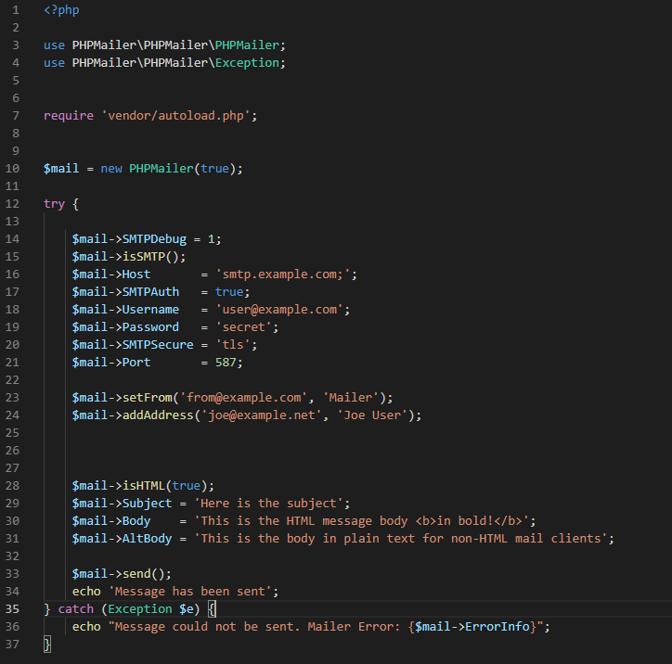

Slide 9
Example Front + Back

Slide 10



Where can you train ?

Slide 11
THANKS!
Does anyone have any question?
hugo1.lachkar@epitech.eu
hugolachkar.com

